Slide 1
DBMS : Looking Back & Path Ahead

Slide 2
Course Summary
Database Overview
  Course Overview: basic definitions, data storage, queries, transaction management and administration
What Data? Requirements collection and analysis
Structuring Data:
Data Models, E-R Model, Conceptual Design using E-R Model
Relational Model
  introduction, integrity constraints, Logical Database Design
Query Languages: Relational Algebra, SQL
Logical Database Design & Tuning
  Stored data in terms of relational data model
  FD, Normal Forms, Decomposition, Normalization, Schema Refinement

Slide 3
Summary (2)
Transaction Management:
Concurrency Control: ACID, Protocols (Lock based, Multiple Granularity, Optimistic, Optimistic 2PL, Timestamp, Multiversion)
Crash Recovery: Crash Recovery: LOG, LOG Records, ARIES Algorithm (Crash , Repeated Crash)
DBMS Labs: Design, Implementation, Querying
DBM Tool : Postgresql
Database Connectivity, Application Development

Slide 4
Evaluation Scheme
Labs and Assignments 20%
InSem Exam 40%
Final Exam 40%

Slide 5
What more to Database?
Application Development
  Database Application Development (Embedded SQL, Connectivity JDBC, Connecting Heterogeneous Databases)
  Front End: Design (flowchart, Activity Diagram, Dataflow Diagram) and Implementation
  Internet Applications (URI, HTTP, XML, JavaScript, Stylesheets, Application Servers)
Physical Design
  Storage and Indexing
    Storage Devices, disks, tapes, data redundancy, disk space management, buffer management, formats
    Tree structured, hash based Indexing

Slide 6
Contd…
Query Evaluation, Query Optimization
Implementation of Transaction management
Distributed Databases & query processing
Web Information Search

Slide 7
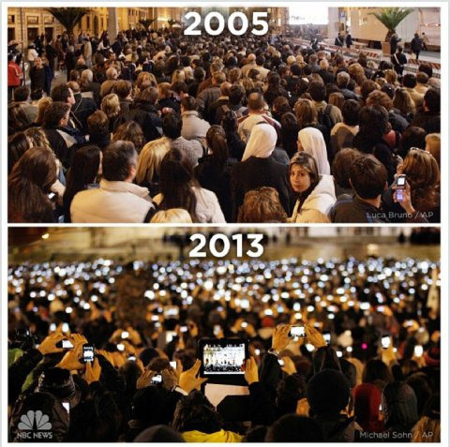

Slide 8
Data on Web
2005 : 1 billion users, more than 3 billion documents
Difficult to find, to access, to present and to maintain the information for wide variety of users
HTML allows browsers to present the information to the human readers
Information content is presented in a natural language
Wide gap between the information available for tools to use in creating and maintaining web page and the information kept in human readable form on those pages
Velocity, variety, volume

Slide 9
Internet
14.3 Trillion - Webpages, live on the Internet
48 Billion - Webpages indexed by Google
14 Billion - Webpages indexed by Microsoft's Bing
672 Exabytes - 672,000,000,000 Gigabytes (GB) of accessible data
43,639 Petabytes - Total World-wide Internet Traffic in the year 2013
Over 9,00,000 Servers - Owned by Google, the Largest in the world
Over 1 Yotta-byte - Total data stored on the Internet

Slide 10
Internet
1.6 Billion - Active Facebook users world-wide
234 Million - Active Twitter users
5.215 Billion hours - Video watched in a month (All websites combined)
8.254 Pb (Petabytes) - Photos added to Facebook every month

Slide 11
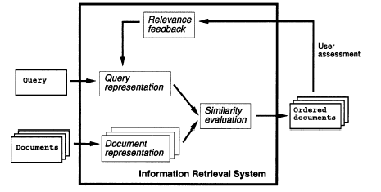
Information Retrieval System

Slide 12
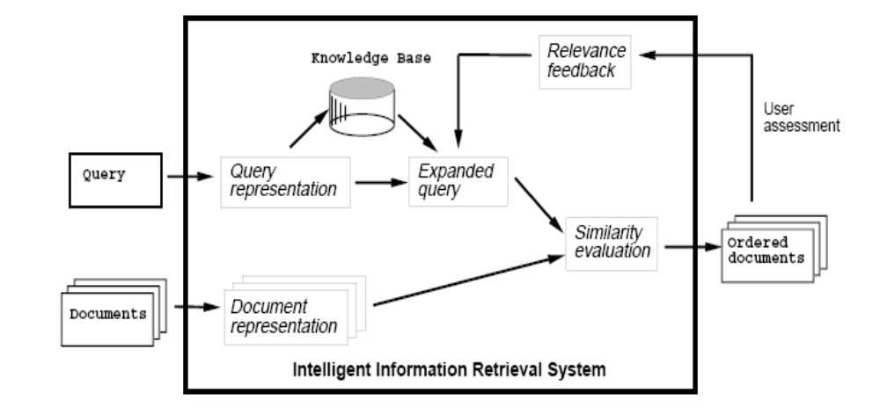
Intelligent Information Retrieval System

Slide 13
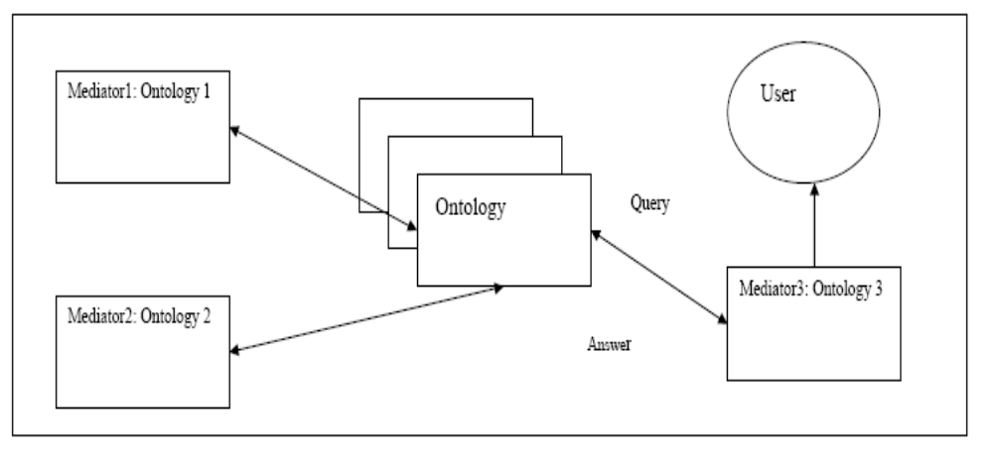
Semantic Web Information Retrieval

Slide 14
Semantic Web
Intelligent search instead of keyword matching
Query answering instead of information retrieval
Document exchange via ontology mapping
Definitions of the customized views on documents
A web of data that can be processed directly or indirectly by machines
Investigating the next generation of the web which manages data intelligently

Slide 15
Semantic Web contd.
The goal is to express the data and rules for reasoning about the data and also allow rules from any existing knowledge representation system to be reused by the web
Use rules to make inferences, choose courses of action and answer questions

Slide 16
Opportunities at DA-IICT
Elective Course: Web Data Management, Sem VI, BTech
Research in Databases

Slide 17
Course Plan (1)
Introduction and Overview: Data on the Web (2)
  History and Future of Web, Semantics and Semantic Web, Semantic Web Stack
Traditional Web Search and Search Engines (2)
  Database search, Keyword, Metadata, Semantic based search, Search Engines, Metadata Standards (DCMI)
Basics of Distributed Database (4)
Web Data Models: (8)
  XML
  RDF/RDFS
  SPARQL
  OWL
  Rules
  Review of W3C Semantic Web Initiative

Slide 18
Course Plan (2)
Web Data Integration and Mapping (4)
  Traditional Systems, XML based Systems, Ontology Based Systems
Ontologies and Ontology Tools (2)
  Object Oriented Technology for Ontology Generation, XSLT, Automation in Ontology Generation, Code Generation
Intelligent Web Search (2)
  Ontology based search, intelligent agents
Querying Web Data (2)
  Query languages for web
Web Databases:(6)
  Semantic Data, Social Data, Sensor Data, Cloud Data (6)
Large Scale Data Management (4)
  Database Issues, Ontology Modeling, Agent Modeling, Automation
  Semantic Web Data Management
Research Issues (3)

Slide 19
What is Big Data?
Datasets that grow so large that they become awkward to work with using on-hand database management tools
Difficulties: capture, storage, search, sharing, analytics, visualizing
Larger datasets allow analysts to spot business trends, prevent diseases, combat crime
Though a moving target, current limits are terabytes, exabytes, zettabytes of data
Scientists working in meteorology, genomics, biological and environmental, internet search, finance research encounter this problem
Datasets are growing because they are increasingly being gathered by ubiquitous information sensing mobile devices, aerial sensory technologies (remote sensing), software logs, cameras, microphones, wireless sensor networks etc
90% of the data in the world today is created in the past two years

Slide 20
Working with Big Data
Using relational databases is difficult
It needs massively parallel software running on thousands of servers
For some organizations, facing hundreds of gigabytes data for the first time may trigger a need to reconsider data management options
For others it may take hundreds of terabytes of data before data size becomes a significant consideration
In 2001 research report, META group (now Gartner ) analyst, Doug Laney, defined data growth challenges as:
Increasing volume
Velocity (speed of data in/out)
Variety (range of data types and sources)

Slide 21
Information Retrieval System

Slide 22
Intelligent Information Retrieval System

Slide 23
Intelligent Information Retrieval

Slide 24
Research in Database
How to manage data?
How to make queries faster?

Slide 25
Research in Distributed Databases (2012-)
Semantic Web/ RDF Databases
Data Partitioning and Query Execution, Query Optimization
  Vertical Partitioning
  Horizontal Partitioning
  Data Aware Hybrid Partitioning
  Structure Indexing Vertical Partitioning
  Responsive Systems
Multiple Ontology
Automation of Models
Cloud Databases
  Data Integration (Big Table and RDF/Relational)
  Query Migration
Web Databases
Social Network Databases
Internet of Things/ Smart City Databases
Agriculture Database: Crop Recommendation System

Slide 26
Work done in Distributed Databases
RDF Data Management: Partitioning and Query Execution
Query Execution using Materialized Views for RDF Data
Query Optimization for Partitioned RDF Data
Query Translation for Cloud Databases
Cloud Databases (Data Migration from Big table to Relational, scheduling)
Big Data Analysis
Design and Analysis of Semantic Web based Systems using Modeling Techniques: Structural and Behavioral
Automation of Code Generation (Models to Java, OWL)
Multiple Ontologies for Semantic Web based Systems

Slide 27
Research in Main Memory Databases (2013- )
Data Management
Hybrid Systems
  Static Identification of frequently used data
  Dynamic Identification of frequently used data
Transaction Management
  Concurrency Control
  Crash Recovery

